Slide 1
REDIS High Availability with Sentinel

Slide 2
Who Am I? Danny Gershman Principal Engineer @ Cinchcast @dannygnj r&d write cool stuff teller of bad jokes
Notes:
Wanna hear a joke about pizza? Never mind it’s too cheesy.
Did you hear about my band 999 Megabytes? We haven’t had a gig yet.

Slide 3

What is Redis? http://redis.io
Notes:
Key-value store in memory data structure server

Slide 4
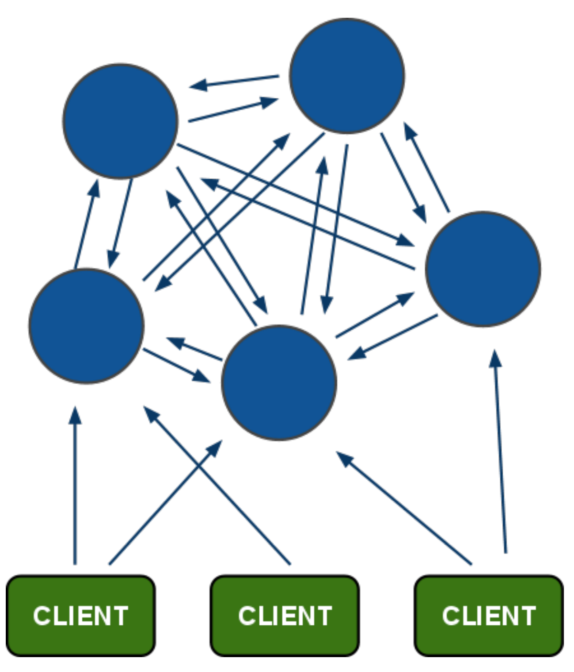
Cluster?
Notes:
Not available yet, date gets pushed off

Slide 5
Spec http://redis.io/topics/cluster-spec
Notes:
Read the spec, note a lot of the spec is in flux as well

Slide 6
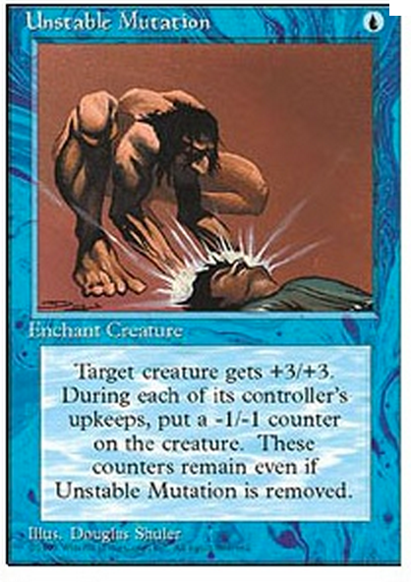
Unstable https://github.com/antirez/redis
Notes:
Cluster is still alpha and in flux, but you can always clone the unstable branch and play with it. Few resources out there and interim solutions available.

Slide 7
Challenges
Notes:
Can only have 1 master per cluster
Slaves are read-only
Failover if master fails is manual

Slide 8
What’s Sentinel? Monitoring – Notification – Auto Failover

Slide 9
Starting Sentinel

Slide 10
Monitoring/Failover Demo
Notes:
Explain sentinel configuration
Spin up redis servers
DEBUG SEGFAULT

Slide 11
Notification Demo

Slide 12
github.com /radius314 /high-availability-demo
Notes:
Key-value store in memory data structure server

